Slide 1
2021 Wage and Hour Update

Slide 2
Wage and Hour Updates
State and Local Issues
  1/1/2022
    State minimum wage increases to $12.75
      Minimum salary for exemption increases to $735.59/week ($38,250.68 annualized)
        But remember – salary is only one factor for exemption!
      Tip credit - $6.38
    City of Portland minimum wage increases to $13.00
      Tip credit - $6.50
  HP 136/LD 183 – An Act to Establish Juneteenth as a Paid State Holiday
    Declares June 19th of each year as Juneteenth and a State holiday, all non-essential state offices to be closed
  SP 367/LD 1106 – An Act to Prohibit an Employer from Charging an Employee for Direct Deposit for Wages
    Enacts 26 MRS Section 621-A(7)

Slide 3
Wage and Hour Updates
Federal Issues
US DOL - Tipped Employee Final Rule (29 C.F.R. § 531.56)
  2018 – Trump Administration rescinded guidance on 80/20 rule
  2020 – Trump Administration proposed rules to officially eliminate 80/20 rule
  2021 – Biden Administration withdrew and resubmitted new proposed rules
    Sets limits on how much time a tipped employee can spend on non-tipped activities when the employer takes a tip credit
    Reinstates 80/20 rule
      Can only take credit when tipped employee is performing “tip-producing” work or work that “directly supports tip-producing work”
          Cannot spend “substantial amount of time” doing “tip-supporting” work
            “Substantial”
              More than 20% of hours worked in a workweek
              More than 30 minutes continuously
      Must pay minimum wage for all time in excess of these limits

Slide 4
Wage and Hour Updates
Federal Issues
Tip Credit Rule – Cont.
  “Tip-producing work” – all aspects of the service to customers for which the employee receives tips
    Bartender talking to a guest, putting the TV on a requested show, getting a specific drink out of storage for them
    Server getting a highchair and coloring book for guests, wiping down a spill at their table
    Busser resetting tables between customers
  “Tip-supporting work” – work that is in preparation of tip-producing work, or which assists it
    Bartender getting a case of drinks from storage to stock the bar, cleaning the beverage station
    Server folding napkins or filling condiment containers during lulls
    Busser setting tables, folding napkins, and rolling silverware before opening
  Effective 12/28/2021

Slide 5
Wage and Hour Updates
Federal Issues
OSHA Emergency Temporary Standard (100+ employees) – 29 C.F.R. § 1910.501(f)
  4 hours paid leave at regular rate of pay for each primary vaccination dose during working hours
    Registering, filling out paperwork, travel, time spent at vaccination site, etc.
    Cannot offset this time with PTO, sick time, etc.
    Not required to pay or reimburse transportation costs
    Not required to pay if employee chooses to get vaccine outside of work hours
  Reasonable amount of time and paid sick leave to recover from side effects for each primary dose
    Can require use of sick leave or general-use PTO, but only if it’s already been accrued
      Cannot make them go into the negative
      Cannot make them use vacation time if you differentiate between types of leave
      Can cap at 2 days per primary dose
  Does not require employer to pay for costs of testing
  Does not require employer to pay for costs of face masks

Slide 6
Wage and Hour Issues
Federal Issues
  OSHA ETS (Healthcare) – 29 C.F.R. § 1910.502
    Reasonable time and paid leave for vaccination
      Registering, paperwork, travel time, appointment, etc.
      Don’t have to pay if employee chooses to get vaccinated outside of working hours
    Reasonable time and paid leave to recover from side effects
    Paid leave may be sick leave, if accrued and available, or administrative leave
    Can cap time for vaccination at 4 hours per dose; recovery at 8 hours per dose

Slide 7
Wage and Hour Issues
US DOL Opinion Letter 2020-19 (December 31, 2020)
  Issue – compensability of travel time for an EE who works remotely part of the day
  Facts – EE normally works in office from 8:00-4:30, 1 hour commute
    Hypo 1 – EE leaves work at 1:00 for PTC; drives 30 minutes to school, then 30 minutes from to home, and then resumes work from home
      Is time driving from office to school compensable? School to home?
    Hypo 2 – EE starts work at home early at 6:00; leaves for a doctor’s appointment at 8:00, drives 45 minutes to doctor’s office, then 15 minutes from doctor’s office to work and works out the remainder of her day at the office.
      Is time driving from home to doctor’s office compensable? Doctor’s office to work? Office to home?
    Answer – no.
      Not “worksite-to-worksite” travel because it is not related to her job duties, it is personal travel
      Not a “continuous workday” because she is completely relieved from duty and is able to use this time for her own purposes

Slide 8
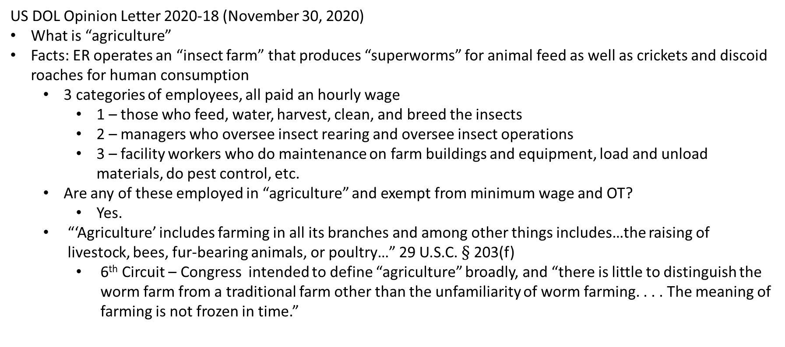
Wage and Hour Issues
US DOL Opinion Letter 2020-18 (November 30, 2020)
What is “agriculture”
Facts: ER operates an “insect farm” that produces “superworms” for animal feed as well as crickets and discoid roaches for human consumption
  3 categories of employees, all paid an hourly wage
    1 – those who feed, water, harvest, clean, and breed the insects
    2 – managers who oversee insect rearing and oversee insect operations
    3 – facility workers who do maintenance on farm buildings and equipment, load and unload materials, do pest control, etc.
  Are any of these employed in “agriculture” and exempt from minimum wage and OT?
    Yes.
  “‘Agriculture’ includes farming in all its branches and among other things includes…the raising of livestock, bees, fur-bearing animals, or poultry…” 29 U.S.C. $§$ 203(f)
    6th Circuit – Congress intended to define “agriculture” broadly, and “there is little to distinguish the worm farm from a traditional farm other than the unfamiliarity of worm farming. . . . The meaning of farming is not frozen in time.”

Slide 9
Wage and Hour Issues
US DOL Opinion Letter 2021-1 (January 8, 2021)
Issue: scope of “administrative employee” exemption
Facts: ER is a life sciences products manufacturer. EEs are “account managers” who have at least a bachelor’s degree and who regularly consult with scientists. They learn about the client’s needs, researches what ER products would meet those needs, and develop individualized plans to pitch ERs products to the client. Lots of autonomy and flexibility to decide how best to develop and engage with clients. Paid base salary above threshold, plus commissions.
Question: do they qualify as exempt administrative employees?
Answer: Yes
Law: Administrative exemption requires: (1) compensation on salary or fee basis; (2) primary duty is “office or non-manual work directly related to the management or general business operations of the employer or the employer’s customers;” (3) primary duties include “exercise of discretion and judgment with respect to matters of significance.”
  Their work is non-manual work directly related to the management or operations of the ER’s clients
    Significant that they were not just “closing sales” but instead worked closely with each client to understand their business and needs and to customize a plan

Slide 10
Wage and Hour Issues
US DOL Opinion Letter 2021-6 (January 19, 2021)
  Issue: is a staffing firm a “retail or service establishment” under the FLSA?
  Facts: staffing firm recruits and places workers in “temp-to-hire” positions with clients. Staffing agency assigns a worker to a client, employs the worker for a trial period during which the staffing firm pays wages/benefits/insurance. If the client and the worker agree to enter into a permanent relationship, staffing firm and worker terminate their relationship.
  Question: are the employees of the staffing firm who are engaged in operating the staffing business (e.g., recruiting, sales, and other functions, but not the temporary workers who are assigned to jobs) eligible for the retail or service exemption?
  Answer: maybe.
  Law: There is an exemption for an EE who: (1) works at a retail or service establishment; (2) whose regular rate of pay exceeds 1.5x the applicable minimum wage; and (3) whose earnings in a representative period are more than 50% commissions. 29 U.S.C. § 207(i).
    “Retail or service establishment”: business that (1) is engaged “in the making of sales of goods or services”; (2) 75% of sales of goods or services must be retail; and (3) not more than 25% of sales of goods or services may be for re-sale.
      Sale of staffing is a “sale of goods or services”
      “Retail” factors: sold to the general public; serves everyday needs of community; at end of stream of distribution; sold in small quantities; not part of manufacturing.

Slide 11
Wage and Hour Issues
US DOL cancellation of PAID program
  Payroll Audit Independent Determination Program – launched in 2018
  Allowed ERs to self-report federal minimum wage and OT violations
    ER would pay wages owed, but could avoid penalties and liquidated damages
  Program terminated January 29, 2021
    Likely signals a greater return to DOL initiated audits
      Presumably a greater focus on liquidated damages and penalties for violations

